Slide 1
Summary 09/08 Filip Krasniqi, Jocelyne Elias and Jérémie Leguay
August, 09/08 2019

Slide 2
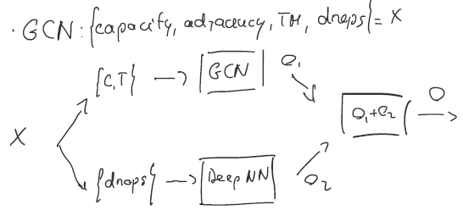
Summary
Learn D = f(TM)
Deep NN
Not able to capture intensities
GCN
Only adjacency: better than a NN with same number of layers
TODO How to make a deep GCN?
Capacity + adjacency: slight improvement
TODO add degree matrix
Learn D = F(TM, drops)
Deep NN (same results)
GCN
Capacity + adjacency + TM on one side
Drops apart
In all cases
Loss much higher that the one of UnderstandingNN
No generalization when more intensities
Additional implementations:
Hyperparameter search (GridSearch) for pytorch
More intensities
Train: S x I x 500
Test: fixed simulation, selection of 3 intensities -> 1500
Validation: same as test

Slide 3
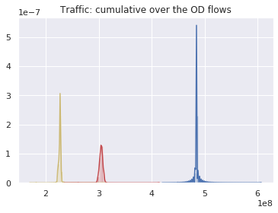
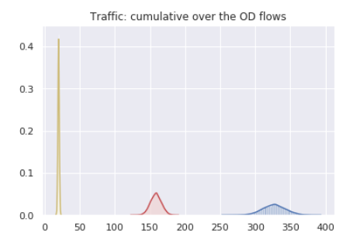
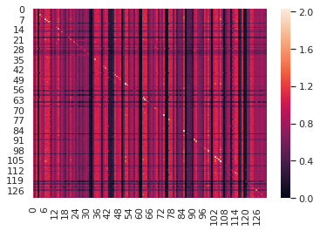
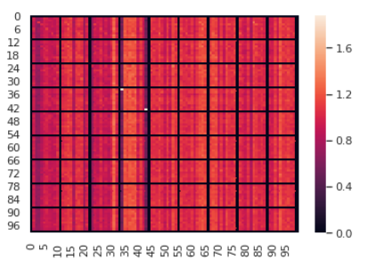
Regimes comparison
Our simulations
Understanding simulations

